Slide 1
dYdX Analysis
Daily/League Trading Findings

Slide 2
Goals/Challenges/ Outcomes
Goals:
Use dYdX API to provide visualizations and in depth analytics on trading leagues and trader behaviour
Challenges:
Lack of technical skills
Hard to find a knowledgeable team member with aligned goals
Data availability
Not all trading data is available through the dYdX API - max 100 traders per day
Outcomes:
Basic data analysis and parameters that can be used for weekly/monthly statistical visuals

Slide 3
Daily Trading -
Quick Stats
Days SInce Trading leagues start: 73 (Feb 09, 2022 - April 23, 2022)
Unique Hedgies Winners: 44
Most Won Hedgies (public ID):
JDUMCLTM - 6 Hedgies
XZZJMKOH - 5 Hedgies
FADVIVYE - 5 Hedgies
TODYTCUW - 4 Hedgies
ATTQKQYJ - 3 Hedgies
11 Uses - 2 Hedgies
28 Users - 1 Hedgie
Average Winning %PNL: +335.73%
Average Winning Absolute PNL: $8,850.64
Highest Winning PNL%: 1109.18% (April 13, 2022)
Lowest Winning PNL%: 67.85% (Feb 27, 2022)
*Only the top 100 daily traders by PNL% are able to be queried via the API

Slide 4
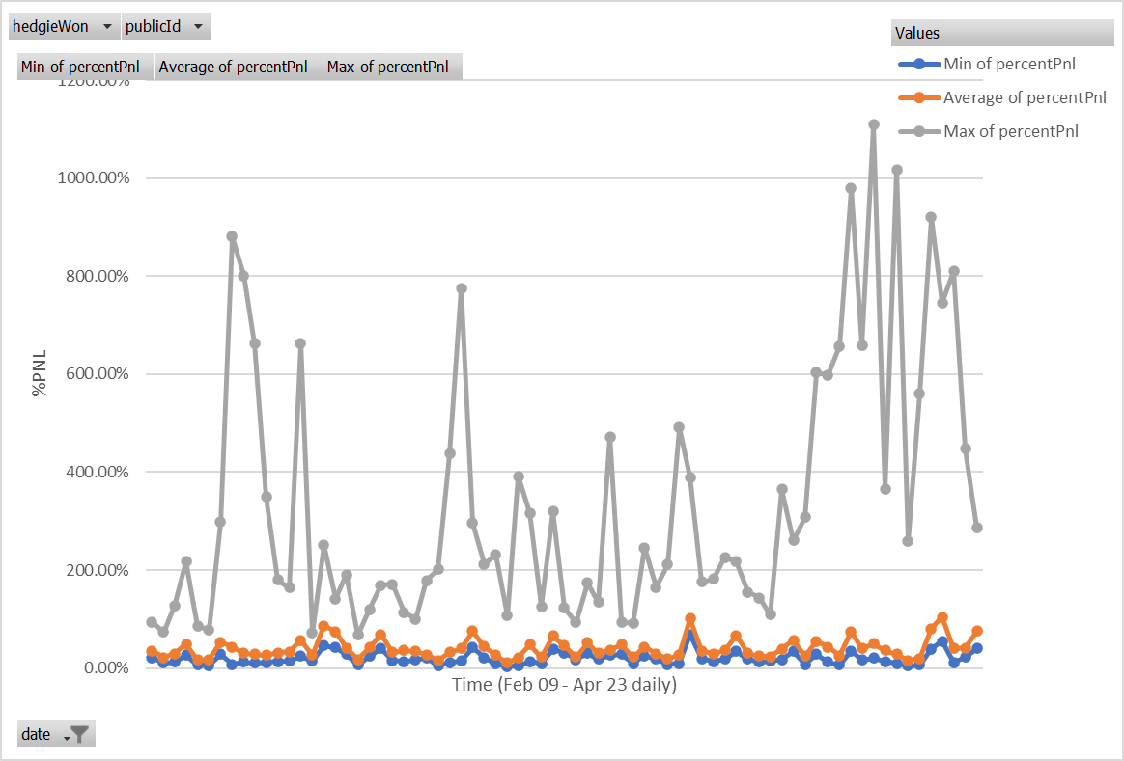
Daily Trading - Deeper Dive
Of the Top 100 by averages (all time):
+19.77% Average Minimum to make the top 100
+40.04% The average top 100 trader PNL
+335.73% The average to Win the day
Huge discrepancy between the average top 100 trader and the winner - only outliers win

Slide 5
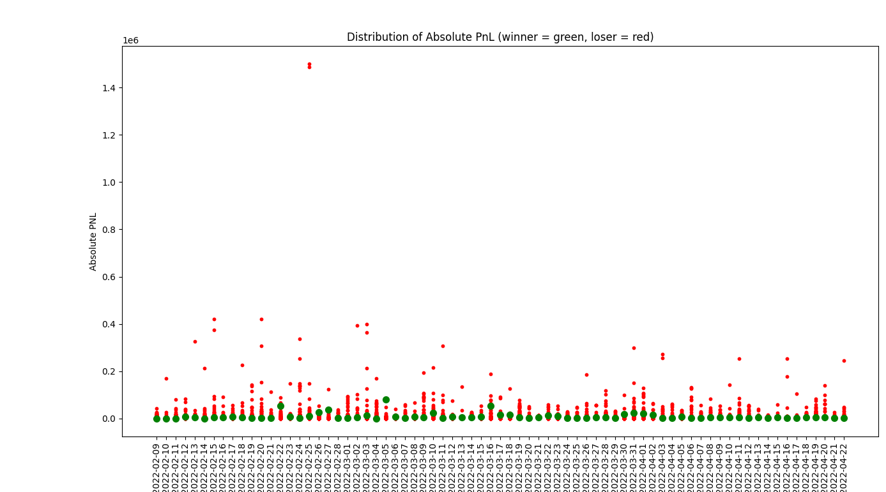
PNL vs Absolute Gains
Avg absolute PNL = $8,850.64
Avg %PNL = 3.357297315
Avg position prior to gains = AVG ABSPNL/ (AVG %PNL +1)
Avg position prior to gains = $2033
Most daily hedgie winners are not moving substantial size
Absolute PNL for daily winners is quite low

Slide 6
The Traders
2496:Total Unique users to make top 100 over all days
7300: Total top 100 appearances
Amongst the 44 Winners:
355 combined top 100 appearances
8.07 average top 100 appearances
The top 1.76% makes up 4.86% of all top 100 appearances
Most top 100 appearances: 18 (1 Win)
Best win ratios: 2 Users won 1/1
1 User won 2/2
1 User won 5/8

Slide 7
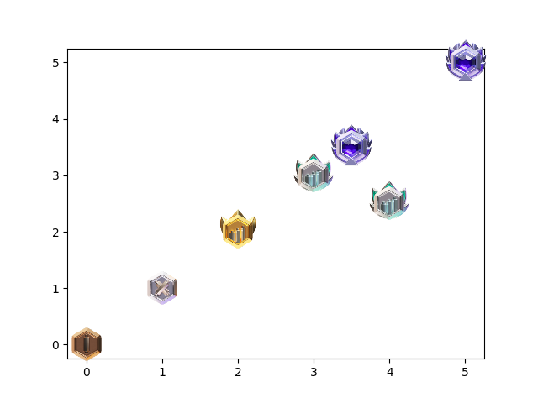
Desired Outputs
Showing an individual trader’s progress through the leagues week by week

Slide 8
Description
Long Description
This project uses the dYdX API (https://docs.dydx.exchange/?json#public-http-api) to analyze data of the top daily/weekly traders. Data is fetched with Python and then visualized using the Matplotlib library and Jupyter. Every trader's unique and anonymous public ID corresponds to their absolute PNL and %PNL for any given day week, etc. We wanted to use this data to analyze existing trends to better understand what strategies the most successful traders use, how often the most successful traders win, and general market trends. We wanted to find what the wining strategies are (to the extent of the data) and how those vary based on different time frames (daily vs weekly).
How It's Made
This project pulled the dYdX API information to parse through the data of the top daily/weekly traders. This data was analyzed with Python and visualized using the Matplotlib library and Jupyter. Every trader's unique and anonymous public ID corresponds to their absolute PNL and %PNL for any given day week, etc. This code can be lighlty adjusted to query this information on a regular basis and provide updated results as needed. The Information was also exported to an Excel and edited in Pivot table for easy searching by a non technical crowd.
Short Description
Analytics dashboard examining dYdX's daily and trading league results with publicly available API data.

